Slide 1


American Monte Carlo Comparison: Tsitsiklis-Van Roy vs. Tilley
Anna Łazarska
Katarzyna Rymar Piotr Mikler
www.agh.edu.pl

Slide 2
Tilley Algorithm
The main idea is to devise a method based on the Monte Carlo simulation to decide the early exercise boundary.
Once the early exercise boundary is determined, an American option can be viewed as a knocked-and-exercised option.

Slide 3
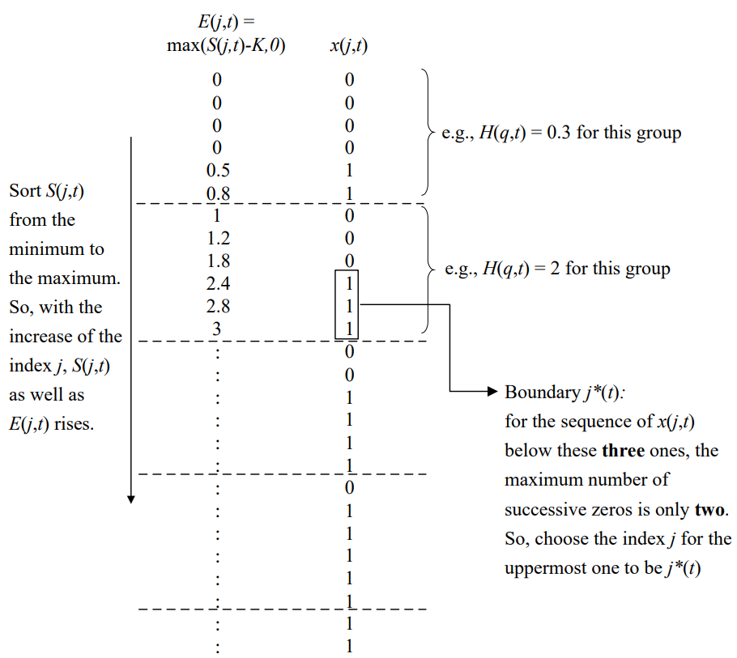
Tilley Algorithm

Slide 4
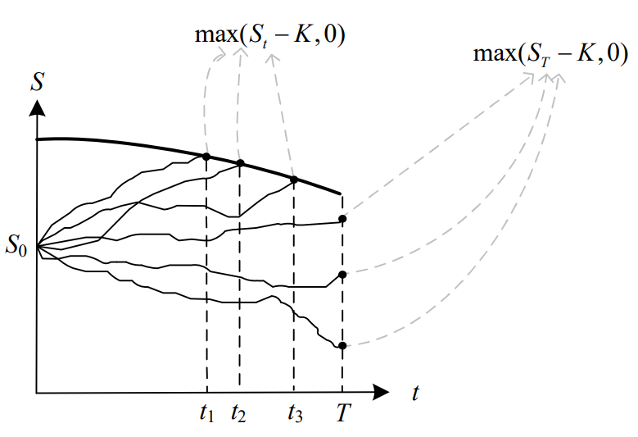
Tilley Algorithm

Slide 5
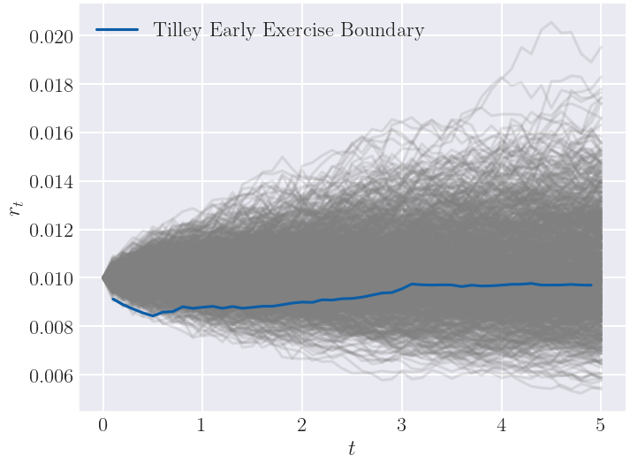
Tilley Early exercise boundary – American Put

Slide 6
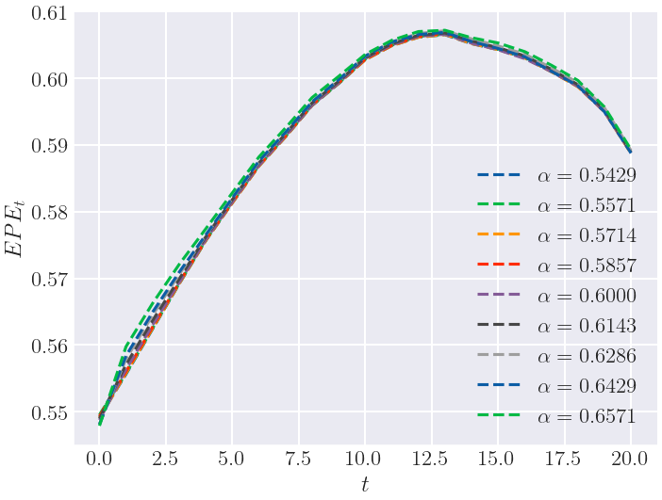

Tilley Bundling parameter $α$

Slide 7
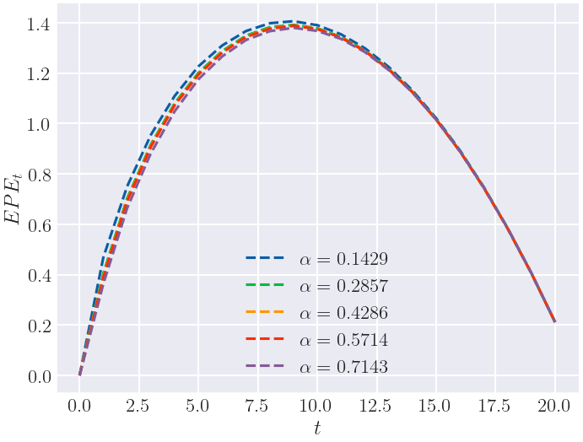
Tilley Bundling parameter $α$

Slide 8


Tsitsiklis-Van Roy Algorithm
We use the regression technique to approximate the conditional expectation function at each exercising date:
We are calculating value of an asset by using:
Difference between Longstaff -Schwartz and Tsitsiklis -Van Roy algorithms:
Tsitsiklis - Van Roy:
Longstaff –Schwartz:

Slide 9
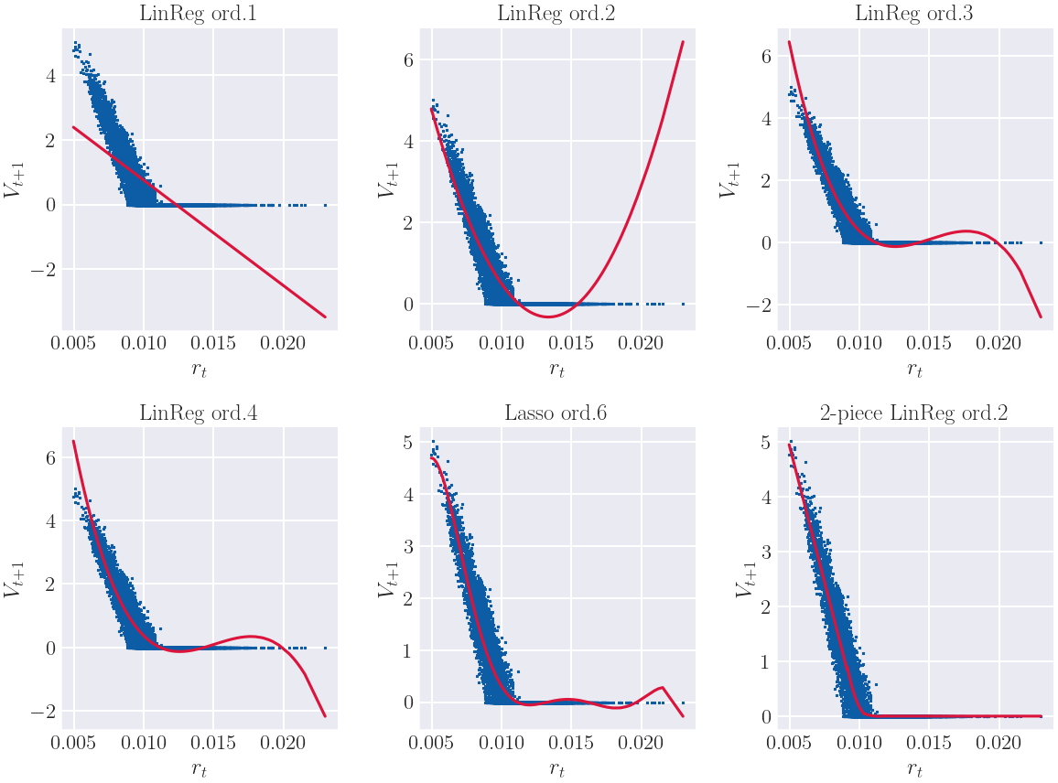
Tsitsiklis-Van Roy Choice of regression

Slide 10
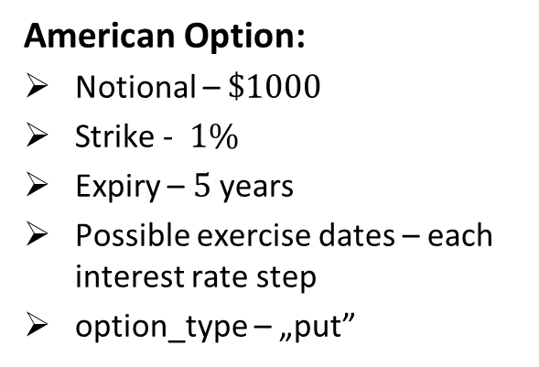
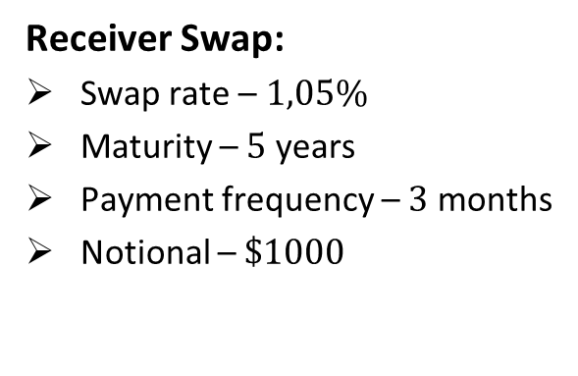
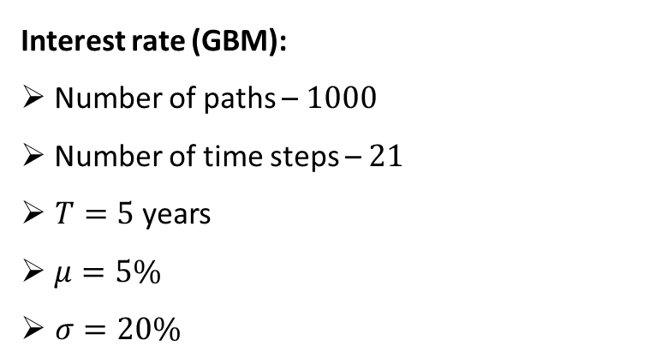
Simulation and derivatives setup
Receiver Swap:
Swap rate – $1,05\%$
Maturity – $5$ years
Payment frequency – $3$ months
Notional – $\$1000$
Interest rate (GBM):
Number of paths – $1000$
Number of time steps – $21$
$T=5$ years
$μ=5\%$
$σ=20\%$
American Option:
Notional – $\$1000$
Strike - $1\%$
Expiry – $5$ years
Possible exercise dates – each interest rate step
option_type – „put”

Slide 11
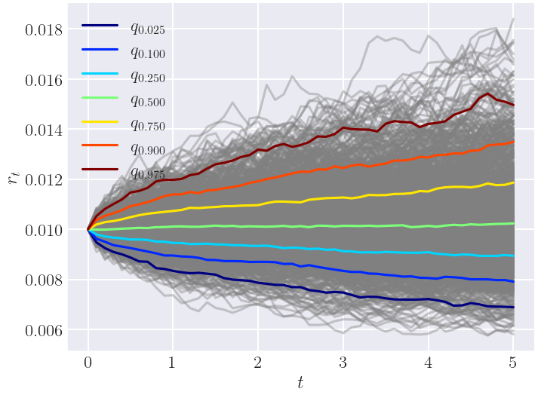
Interest rate Distribution quantiles

Slide 12
American Option

Slide 13
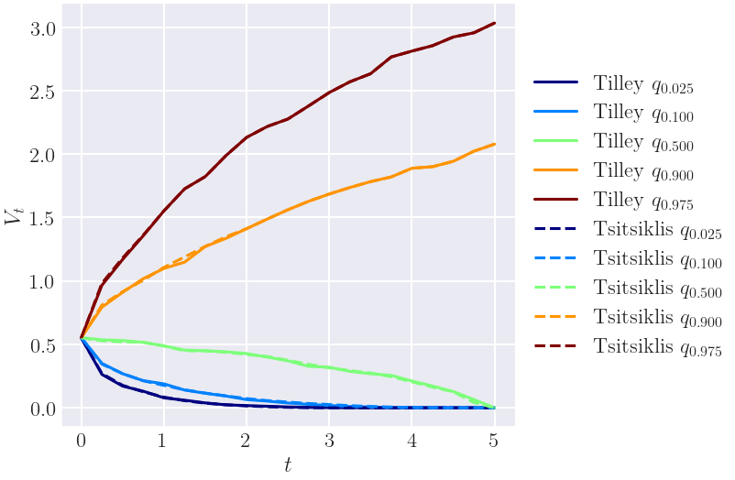
American Option Tsitsiklis-Van Roy vs Tilley – exposure profiles

Slide 14
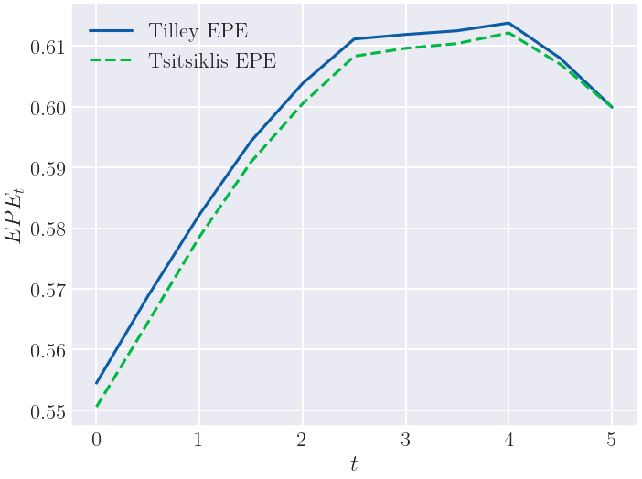
American Option Tsitsiklis vs Tilley – Expected positive exposure

Slide 15
Interest Rate Swap

Slide 16
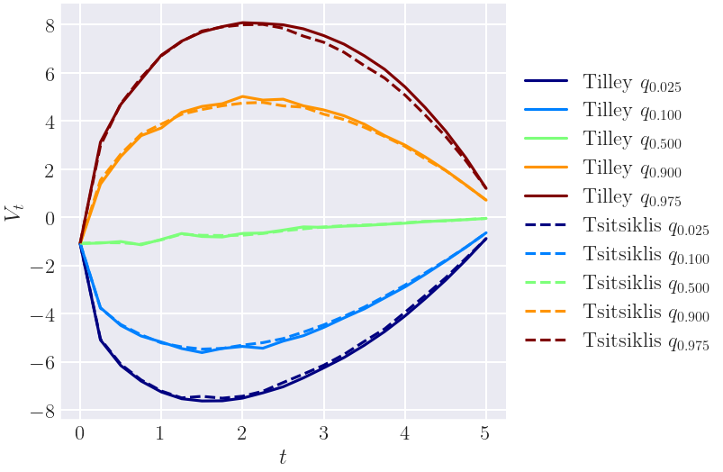
Interest Rate Swap Tsitsiklis-Van Roy vs Tilley – Exposure profiles

Slide 17
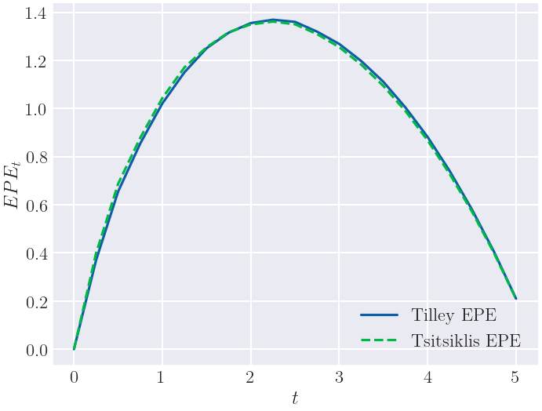
Interest Rate Swap Tsitsiklis-Van Roy vs Tilley – Expected positive exposure

Slide 18


Thank you for your attention!

